Slide 1
Science: Freedom to Advance Wound Care
John Boswick Memorial Lecture
SAWC/WHS, April 16, 2011
Laura Bolton, Ph.D, Adjunct Assoc. Professor
Department of Surgery (Engineering) RWJUMS
New Brunswick, NJ, USA
President, BoltonSCI, LLC
Notes:
Thank you Rob for your kind intro.
and Dr. Baine, for your gift of seeing some of our wound care practices as the AHRQ sees them.
And thank you all for the opportunity to honor John Boswick by sharing the vision of how science can free you to advance your practice and improve your patients’ outcomes.

Slide 2
Objectives
Participants will be able to...
Separate fact from fiction about evidence-based wound care
Realize how science improves wound care outcomes
Appreciate value of reporting progress toward patient and wound goals
Notes:
Today we’re Mythbusters!
We’ll separate myth from reality about EB WC,
then show how using science-based interventions improve WC outcomes and how monitoring progress toward those outcomes adds value to your practice.

Slide 3
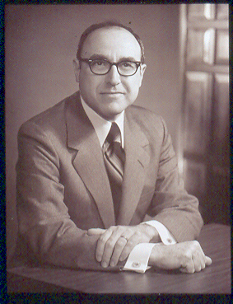
When I first met John Boswick…
Randomized clinical trials convinced him.
Notes:
First please allow me to honor JB .
He had a lot to do with why I’m standing here.
I met him at the Surgical Infection Society many years ago.
He was always interested in people.
I was novice scientist who had just looked up from 10 yrs at bench to discover that the science on moist wound healing (some studies 40 yrs before!) wasn’t being used—or even believed.
His eyes sparkled when I showed him RCT evidence that wounds healed twice as fast when kept moist, with half the pain and 1/3 the infection rate. He encouraged me to share the evidence with others: said that they would listen too. Thank you John Boswick for mentoring me on my EB journey.
It started with separating fact from fiction…
Another slideNeither of us realized it, but those RCTs were ushering in a revolution in wound care!
He told me to wield that wound science and taught me who to talk to, where to go, what to do and how to pack my message into a 30-second “elevator conversation” to win audience with “C-level” folks (CEOs, CFOs, Chief Medical Officers) to involve the top medical figures in sharing and realize the vision of what professionals wielding science can accomplish for their wound patients, themselves and their institutions.
One specific comment for slide 3.
RCT’s are also needed to evaluate safety.
Controlled cohort studies are also valuable to support safety (!!) and effectiveness.

Slide 4

Evidence Based Wound Care
FICTION | FACT
Ignores individual patient | Patient oriented
Not enough science | >5000 RCTs+ RCT reviews
Stifles innovation | Science speeds innovation
Ignores clinical judgment | Builds on clinical wisdom
Tyranny of the RCT | Freedom to learn facts
Opinion is best | Best evidence gets results
Notes:
Let’s start by busting some myths about EBWC.
There’s hype that EBWC…
Let’s illustrate each of these points…

Slide 5
FACT
EB Wound Care Is Patient-Oriented¹
Traditional
Clinician oriented
Focus on practice
Parental approach
Expert opinion-based
Evidence-Based
Patient oriented
Focus on outcomes
Informed decision
Science-based
¹ Jaeschke R, Guyatt GH, Meade M. Adv Wound Care 1999; 11(5):214
Notes:
Does EBWC really ignore the patient?
The reality is it focuses science to inform cooperative patient/clinician decisions to get the best outcomes oriented toward each patients specific needs and goals.
EBM is more than simply basing care decisions on the best available science. Instead of focusing on the practice of medicine, it focuses on the goal the patient and practitioner agree to attain.
It replaces the traditional approach of the “physician deciding what is best for the patient”
The patient participates in making an informed decision about the choice of care modalities, based on what science there is to support the safety and efficacy of that modality and what the patient can or will tolerate.

Slide 6
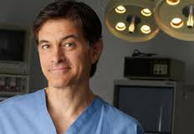
Doctor's Visit
Traditional Evidence-Based
“No procedure is one size fits all.
I discuss with my patients their unique situation, and we reach a decision together.”
Take new findings into account.
Oz, M. AARP Magazine, Jan/Feb01:18
"I think you should take this therapy."
"Be sure you follow the instructions."
Notes:
A major difference between EBM and traditional medicine is a shift in focus from the physician to patient. The focus in the traditional doctor’s visit is on the physician. Once the history, physical and diagnosis is done, the traditional doctor's visit ends, with the Dr. saying, “ I think you should take this therapy. Be sure you follow the instructions.”
The EB doctor finishes with a clear statement of “Based on the clinical evidence you have A or B options of therapy with these outcomes/costs/side effects. Which do you prefer?”
Its about informed patient AND clinician choice.
Instead of ordering patients to comply with a therapy they may not be able to afford or use, the evidence-based approach invites the patient to participate in making an informed decision about which therapy may work best for him/her and best suits the patient’s situation.

Slide 7

FACT: Ample Science
NOISE
SIGNAL
Notes:
Let’s bust Myth #2: Not enough good science ( RCTs)? Wrong it’s growing faster than ever before. I did MEDLINE searches for each decade of randomized and non-R studies in wound care and found that The problem is there is so many publications parading as science that the signal to noise ratio is very low. Case studies lay the groundwork for clinical science, but it takes a RCT to tell you in an unbiased way that one intervention works better than another and that’s what helps you decide what to use for a given patient.
If you sum up all RCTs in wound care over the past 50 years…
To do this I did MEDLINE searches for controlled studies x wounds for every 10 years since 1960 when MEDLINE started.
This graph shows how fast both hype and science are growing.
Next one is cumulative over the last 60 years.
WC evidence has increased during the last 50 years to more than 5218 randomized controlled studies (clinical and pre-clinical) available to inform wound care decision makers. But there’s a lot more noise (uncontrolled or potentially biased studies) than signal (well performed RCTs). This means it’s hard to tell the real facts from “hype”. In other fields where this happened, clinicians (throw up hands) ignore the good evidence (e.g. pediatrics).

Slide 8
State of Wound Care Science
MEDLINE Search January 2011
3,285
Randomized
Clinical Studies
1,933
Randomized
Preclinical Studies
86,895
Non-randomized Studies
Notes:
…you find more than 5000 RCTs (~3000 clinical ~2000 preclinical) there to support your clinical decision making! Just because there’s so much “noise” doesn’t mean we should ignore the science! It’s no reason to “dumb down” wound care and listen only to the noise.
Wound care patients deserve the best. You can use the >”noisy” 86,000 non-randomized studies to support product/protocol safety or highlight aspects of performance. But they do not tell you what works best i.e. efficacy compared to some other intervention or accepted standard of care.
How can you sort out evidence that may help your clients/patients?

Slide 9
Hallmarks OF Good Evidence^{1,2}
Randomized, unbiased assignment of patients
Independent, blinded comparison of treatment effects to accepted standard
Efficacy and safety measured and reported
Valid outcomes measured reliably
Clinically relevant, patient-centered outcomes
Representative, similar patient samples
Adequate sample size, timing, scope, follow up
¹Jaeschke R et al. Adv Wound Care, 1998; 11(5):214-218
² Gray M. et al. JWOCN 2004; 31(2):53-61.
Notes:
The wonderful thing about science is that, unlike opinion, there are clear criteria so you know good science when you see it. Essentially these hallmarks help prevent bias from creeping into a study and assure that it is clinically relevant, valid and repeatable.
There are clear, recognized criteria for good clinical evidence. Totally transparent, complete and unbiased: Others have summarized these far better than I—refs included here for those of you who want to delve deeper can download use this to start.
As a wound care professional, you are often the main patient educator, the main communicator of “what works best” (i.e. is most effictive) for your patients helping them decide what is likely to give them the best clinical results, most safely while meeting their quality of life and economic goals.
So you are the one who needs to be able to recognize the best available evidence for that condition.
The hallmarks of good evidence to support evidence-based decision making are listed here.

Slide 10
Others Have Sorted RCT Evidence
Signal From Noise For You http://www….
AHRQ Evidence Reports
  ahrq.gov/clinic/
Cochrane Initiative:
  cochrane.org/
National Guideline Clearinghouse
  guideline.gov/
National Library of Medicine: MEDLINE
  ncbi.nlm.nih.gov//PubMed
Notes:
If you had to wade through all this evidence, it would be quite a task.
The good news is that much of the work of summarizing the evidence has been done for you. You can find evidence or systematic reviews or evidence based guidelines at many websites, including these. Or you can do your own lit searches at the PubMed and other websites.

Slide 11
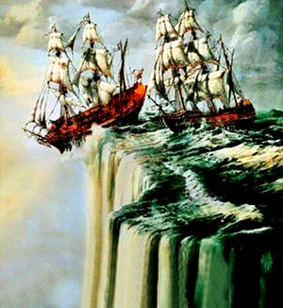
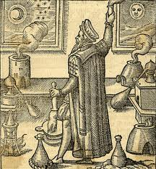
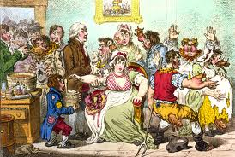

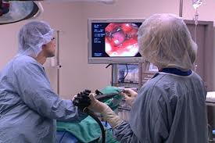
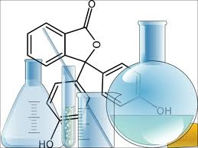
Fact: Science Speeds Innovation
Physics / Chemistry / Medical Practice
Astronomy Biology Uses All
Notes:
Busting Myth #3: That it stifles innovation. Actually S fosters disc & inno
Science lead us toward more fruitful paths
From a flat earth into space,
From the dead end of alchemy to new materials and bio-material interactions
From bleeding out the “bad humours” (what really killed George Washington!) to diagnostic tools and therapies that actually work.
Science brought humanity out of the dark ages, put humans on the moon, improved patient outcomes in fields as diverse and complex as oncology, cardiology and endocrinology. Now it’s time for patients with wounds to benefit from the growing body of wound care science!

Slide 12
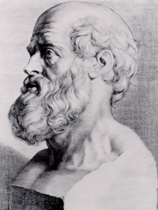
EB Wound Care Means
Freedom to Learn Facts
Hippocrates 460-400 BCE
Law, Book IV
“There are in fact two things, science and opinion;
the former begets knowledge, the latter ignorance.”
Notes:
Bust myth # 4 & 5: It doesn’t ignore clinical judgment: As Hippocrates said, it builds on clinical wisdom and by adding genuine knowledge to clinical judgment.
Instead of the “Tyranny of the RCT” science frees you to learn the facts and supplement your practice with genuine knowledge!
These principles have helped other aspects of medical care: Wound care has a strong and growing foundation of RCTs. Wound care patients deserve to benefit from that science! Perhaps it is time to follow his advice.
Those who have done so applying evidence-based wound care protocols or algorithms to supplement their clinical experience have benefited their patients with improved outcomes and fewer complications, while saving money and resources.

Slide 13

If opinion is as strong as relevant RCT evidence in informing care decisions…
Whose
Opinion?
Notes:
It frees you from the real tyranny of untested opinion!
RCTs aren’t tyranny. They free you to find out what really works so you don’t have to accept the tyranny of opinions that keep wound care in the dark ages. That brings us to busting the final myth: that opinion is as strong as RCT Evidence. In fact using RCT evidence improves outcomes.
If opinion is as strong as relevant RCT evidence in informing care decisions, then WHOSE opinion?
Is it the person who talks loudest?

Slide 14
Which Evidence is Stronger? http://www.ahrq.gov/clinic/epcsums/strengthsum.htm
Strongest Level
A > 2 RCTs
B 1 RCT +…
C …
Weakest Level
RCTs
SR, MA
Convenience
Historical Controlled
Relevant Animal CT
Case Controlled Studies, Case Studies, Uncontrolled Models
(Usually in vivo > in vitro)
Systematically Validated Opinion
Consensus Statement
Individual Opinion
Notes:
To avoid shouting matches and recognize the best available evidence for improving patient outcomes, other fields of medicine have established grading systems for strength of evidence that have improved patient outcomes in areas as diverse as cardiology, oncology and dermatology.
Is there any reason why wound care professionals and patients should not reap these benefits too?
RCTs are the strongest evidence because randomization limits bias. They require that groups are comparable at baseline.

Slide 15
Fact: Evidence Supplements Wisdom
Clinical
Wisdom
Quality
Evidence
Improved
Outcomes
Notes:
EBWC is not tyranny, but frees you and your patients from the tyranny of others’ opinions and lets you see clearly what we know and what we don’t know.
Yes each patient is unique and your clinical wisdom is vitally important.
And it only makes sense to supplement your own wisdom with the best available relevant scientific knowledge garnered by others!
The final fact replacing myth is that E supplements one’s own clinical wisdom and experience, it doesn’t replace it . It adds to your experience the experience of others, and the more RCTs there the less biased and more truthful it is. It is difficult to imagine why anyone would want to ignore relevant quality evidence with the potential to improve patient outcomes.

Slide 16
Realize How Evidence Improves
Wound Care Outcomes
BRIDGING THE GAP BETWEEN EVIDENCE AND PRACTICE
Notes:
And that brings us to our second CE objective: Realizing how E Improves WC Outcomes: how you can use evidence to improve your patients’ outcomes. Lia van Rijswijk will address this in more depth in concurrent session #38 following this session on Barriers to Implementing EB Practice, so we’ll only lightly touch the surface.
Now let’s explore clinical pearls about how to integrate evidence into wound care practice, what you can do today to improve patient care and outcomes that patients want.

Slide 17
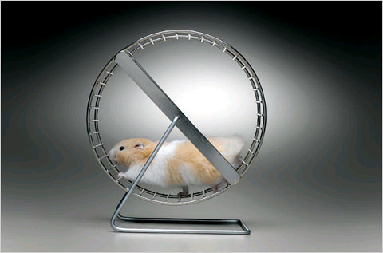
“Quality health care means...
Doing the right thing
At the right time
In the right way
To the right person
Having best results possible.”
Agency for Healthcare Research and Quality
As quoted by Terris King, Office of Clinical Standards and Quality Centers for Medicare and Medicaid Services
CMS, July 15, 2005,
Notes:
Evidence helps us do the right thing…. It does not mean caring for patients and caring for them running in the same circles getting nowhere.
Best available WC evidence helps us know what “The right thing” is to do and how and when to do it and what kind of patients/wounds it works on.

Slide 18
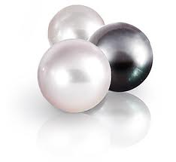
Pearls For Using Evidence-Based Wound Care
Start with your patients
Multidisciplinary team
Build, use EB protocols
  Patient-oriented GOALs
  Evidence-based ACTION
  Measure PROGRESS
System-wide Quality Improvement
  Training, tools and check lists
¹ Morrell C. et al. Nurs Stand. 2001 Apr 11-17;15(30):68-73.
² van Rijswijk L. Amer J. Nursing 2004; 104(2):28-30.
³ Hermans MHE, Bolton LL,. Remington Report, 2001; 9(6) Suppl. 1:6-8
Notes:
The few pearls I can give you here are…

Slide 19
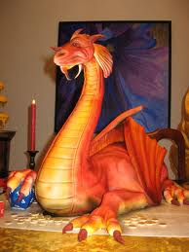
EB Practice Starts With
YOU and YOUR PATIENTS
Know your wound patients
  Etiology / diagnosis
  Needs, wishes, goals
  Risk factors
  Measured progress
  Expected mean healing time ¹
Depth | Venous Ulcer | Pressure Ulcer
Partial-Thickness | 29 days (n=30) | 31 days (n=134)
Full-thickness | 57 days (n=124) | 62 days (n=373)
¹Bolton L, McNees P, van Rijswijk L et al. JWOCN 2004; 31(3):65-71
Notes:
How many of you actually care for real patients with wounds? Hand! What is your case mix—by etiology? How long does it take each to heal in your practice? If you don’t know, NOW is the time to Face your dragons and find out! By facing these important challenges, and using EBWC to resolve them you can win WC success!
Did you know that it takes a FT VU or PU twice as long as a matched PT one to heal?
To do the right thing, you need to really know your wound patients.
Take a close look at your practice: What is your case mix? Which ones are the most challenging wounds to heal? Full-thickness PU and VU take twice as long to heal. How can you overcome the barriers to let you heal wounds early before they become FT and take twice the time and resources to heal?
What do the patients really want? EB practice is about achieving those goals!
What do you want for your patients? Are your goals consistent with those of your patients?
If you want your DFU patient to stay off that insensate foot and the patient wants to work all day and dance all night, what do you think they’ll do? Find common goals that you both agree on to achieve, then use best available evidence to get there.
How many of you measure wound progress? Do you know how long it takes each major etiology wound in your practice to heal? How long if it is partial-thickness compared to full-thickness?
Know your results? Do you know the evidence on risk factors for delayed healing for each major etiology wound to heal
in your care? in your institution? How are you doing relative to other similar professionals in your institution?
Make an EB checklist of things you need to know about every patient in your care! Wield that checklist to improve outcomes.

Slide 20
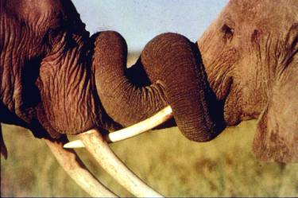
Multidisciplinary Team’s Work!
The wound is attached to
A PATIENT!
Diagnose wound cause
  Vasculature
  Nutrition
  Endocrinology
  Immune Disorders
  Infection
  Excessive/Prolonged Pressure/Moisture
  Repeated Physical or Chemical Trauma
Notes:
You may not be able to diagnose and correct all causes of tissue breakdown alone.
Evidence will help your team reach an accurate diagnosis.
Many chronic wounds require a multidisciplinary team to diagnose and correct wound cause(s).
For example, leg or foot ulcers may require a vascular consult.
Pressure ulcers often require a nutritionist on their team.
Diabetic foot ulcers require an endocrinology specialist to help control hyperglycemia.
Etc.
It is important to remember that the patient is on the wound care team as well.
Progress can be slow unless the patient participates.

Slide 21
Evidence-Based
ACTION PLAN TO REACH GOALS
PREVENT PU, VU, DU
OPEN WOUND
  HEAL
  RELIEVE PAIN
  MANAGE ODOR
EDEMA
  REDUCE IT
DEBRIS
EXUDATE
DRY
NECROSIS
CLEANSE
ABSORB
HYDRATE
Notes:
Once you, your team and patient agree on diagnosis and goals of care, the evidence will point you to interventions that work to achieve those goals.
An example Action Plan to reach wound care goals might be this. …
To make it evidence based, simply go to the literature or websites or E-B guidelines to find ways to reach each of these goals based on the best available evidence for the type of wound and patient you are working with..

Slide 22

Build Protocols and Checklists
From Evidence-Based Guidelines or
Content Validated “Guidelines of Guidelines”
Venous Ulcer & Pressure Ulcer Guidelines of Guidelines©
WHS
  CAWC
Solut ions
WOCN
NPU AP
www.aawconline.org www.guideline.gov
Notes:
…or go to the AHRQ National Guideline Clearinghouse to find E-B guidelines like those of WHS and others
…or use one of the AAWC’s evidence-based Guidelines of Guidelines, where you can find content-validated evidence-based recommendations for venous and pressure ulcer management summarized from all related contemporary guidelines.
Put these relevant E-B recommendations to work improving your patient & wound outcomes by using them on your team’s protocols and checklists .

Slide 23
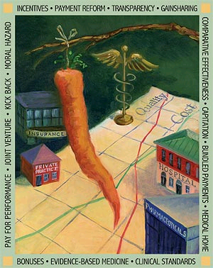
System Wide Quality Improvement
Multidisciplinary team
  Involve C-level folk
EB Tools:
  Check lists
  Protocols
  Training: all involved
Feedback to all
Reward successes!
Document progress
Notes:
And make sure the QI is System Wide!
So you all get that P4P that’s coming down the road!
Quick recap of your second CME goal: (Lia van Rijswijk will show you how to do this really well in the next session)
…
And when you document progress you are doubly rewarded:…next slide
Extra: you’ve found a challenge to focus on, get your 30-second elevator conversations ready for C-Level people in your system CEO, CFO, CMO so they each know WIFM-how aspects of HC system they’re responsible for will improve. You’ll need them behind your QI initiative for credibility and resources to get the job done.

Slide 24

VALUE OF MEASURING PROGRESS
Improve Clinical Outcomes!
Stand Out in the Crowd!
Notes:
This brings us to the final CME goal: adding value to your practice by measuring progress.
Want to stand out in a crowd? Know your outcomes! When you measure patient progress toward the goal, you become one of the happy few who know whether you’re patients are moving forward toward their goals of care—or if not, you learn and correct the action plan early enough to put them back on track before disaster happens.
First we’ll see how measuring healing progress can improve wound care outcomes.
Then we’ll celebrate successful wound outcomes achieved by those who applied evidence-based protocols of wound care!

Slide 25
Notes:
E for this statement was brought to you by Kurd Margolis & colleagues in a 74-center RCT where clusters of centers were randomized to provide wound care giver feedback on risk factors for delayed healing for 1506 VU and 1810 DU in their care.
Providing the caregivers feedback that their patients were not on the path to healing based on 4-week wound area reduction significantly improved 24-week healing outcomes.
When you think about it it really just Psych 101: You can’t even learn to bend your elbow without feedback—how can we expect to heal wounds without it?
Knowing patient/client risk factors and progress improves healing outcomes.
did an large prospective randomized cohort study:
Methods
Existing electronic databases within 74 centers were used to provide one of four kinds of feedback to wound care providers for patients with either a VU (n =1506) or a DFU (n = 1810). Each center was considered a “cluster” randomly assigned to receive either no prognostic information (20 centers), baseline prognostic information only (19 centers), prognostic information based on 4-week wound area change (17 centers) or prognostic information at both baseline and after 4 weeks of treatment. The educational intervention gave wound care providers a facility-specific printout with the likelihood of healing within 24 weeks for VU or 20 weeks for DFU but no added guidance on clinical treatment of the patient or wound. The baseline prognostic printout included likelihood of ulcer healing based on VU area and duration or DFU area, duration and depth. The 4-week prognostic printout informed providers that the patient had or had not passed a 4-week healing landmark of being at least 70% likely to heal in 20 weeks, as defined by complete epithelization or not requiring a wound dressing for at least 2 weeks. Healing outcomes were analyzed using chi-square analysis, with logistic regression correcting for effects of patient age, gender, initial wound area, duration and, for DFU, depth.
Results:
Both VU and DFU likelihood of healing by study end improved significantly, even when corrected for age, gender, baseline ulcer area and duration differences on enrollment, DFU patients with wound care providers informed only of healing predictions based on 4-week healing progress were 1.5 times more likely to heal in 20 weeks than those whose providers lacked this information (p < 0.05). No other DFU healing prognosis significantly affected healing improvement. VU patients whose wound care providers knew either baseline or 4-week healing predictions or both were 1.4 times more likely to heal in 24 weeks than those who did not (p< 0.05).

Slide 26
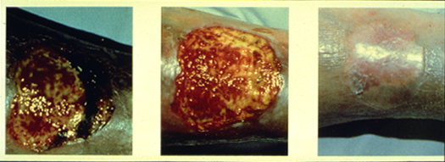
Meta-Analysis of Controlled Studies Measuring Venous Ulcer Healing
(N=530)
Cost:
$1873
per
patient
healed
(N=130)
Cost :
$15053
per
patient
healed
(N=223)
Cost:
$2939
per
patient
healed
Kerstein. et al. Disease Management & Health Outcomes 2001:9(11);651-663.
Notes:
And when you do measure those results, here are benchmarks for what can you expect when you use EBWC? EBWC heals more VU at lower cost.
Kerstein et al. did a meta-analysis of wound care studies reporting healing outcomes for any intervention with > 100 patients. They reported that using EBWC with compression and a primary HCD, healed more VU than gauze after only 4 weeks of care and cost less to heal each wound during 12 weeks.
e.g. In a meta-analysis of controlled studies using compression + dressings and measuring venous ulcer healing for up to 12 weeks, of the 3 VU interventions with measured controlled study outcome evidence on >100 patients each in 2001, Kerstein and colleagues reported that Hydrocolloid dressings provided healing advantages (significant at 4 weeks).
Based on a Delphi panel estimating costs of materials and labor, the authors estimated thatHCD use saved over $1000 to heal each venous ulcer patient compared to use of gauze.

Slide 27
E-B Skin Care Reduced Pressure Ulcer Incidence, Costs: 2 Long Term Care Sites
Baseline: 6 months
  Traditional Care
  Measure costs, outcomes
Solutions® Phase: 6 mo
  Traditional or E-B formulary
  Measured costs, outcomes
Results
  Reduced cost/time to heal
  Reduced costs of care
  Lower incidence new ulcers
P.U. Incidence reduced:
13% 7% 2%
6-Month Cost: $22140 $4918
to manage all n=32 n=40
Stage II P.U.
Lyder et al., Ostomy/Wound Management, 2002; 48(4):52 – 62.
Notes:
EB C prevents PU. After a 6 month baseline of 2 LTC sites with a PU Incidence of 13%, using an EB protocol with either traditional formulary at one facility or an EB formulary at the other, Lyder et al. reported significantly reduced PU incidence and St II PU healing time with the general EB protocol with even lower PU incidence and costs of care in the facility that added EB formulary to the EB protocol of care.

Slide 28
Evidence-based Protocols Reduce Home Care Pressure Ulcer Prevalence
Hanson D, Langemo D,, et al. Home Healthcare Nurse, 1996;14(7):525-31
Setting: Hospital-based home care agency
Pre-protocol 19% prevalence
Protocol: skin care standards
  2 in-services by authors
  Braden Scale
  Interagency committee met
  4 prevalence audits
Notes:
Hanson Langemo and colleagues taught caregivers EB techniques to cut PU prevalence by more than half. Measured PU prevalence in a hospital-based home care agency before conducting an evidence –based inservice on using the Braden Scale and PU prevention and met regularly with their interagency committee. Prevalence stayed down at prevalence audits at 4, 8 and 18 months after the inservice.

Slide 29
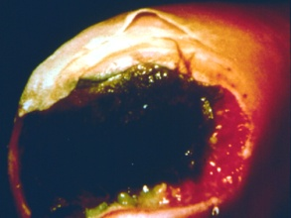
Using Braden Risk <18 To Focus E-B Pressure Ulcer Care Reduced Incidence and Saved $$
Xakellis G et al. Advances in Wound Care 1998, 11(1): 22-29
Notes:
Xakellis et al used Braden Scale Risk <18 in their LTC settings to focus E-B PU care on the highest – risk patients and focus on each patient’s most important areas of risk. They reduced the incidence of new PU in 6 months from 23% of clients developing a new PU in 6 months before E-B care to 6% in 6 months after implementing the protocol.

Slide 30
Evidence-Based PU Prevention Protocol
Increased Preventive Mattress Use (p<0.005)
Makai et al. Cost Effectiveness Resource Alloc. 2010;8:11-24
Notes:
In a prospective “before and after” study, Makai et el used an evidence based protocol to reduce PU and resource use. The main change in interventions was an increase from 27% to 45% use of preventive mattresses, resulting in a drop in PU prevalence and incidence, mainly due to fewer Grade 2 Pressure Ulcers.

Slide 31
Meta-Analysis of Controlled Studies Measuring Stage 2-3 Pressure Ulcer Healing
(N=281)
Cost:
$910
per
patient
healed
(N=136)
Cost :
$1267
per
patient
healed
(N=223)
Cost:
$2939
per
patient
healed
Kerstein. et al. Disease Management & Health Outcomes 2001:9(11);651-663.
Notes:
EB care works for healing PU too: In the same meta-analysis by Kerstein and colleagues found more pressure ulcers healed using PU protocols of care including one hydrocolloid dressing than if gauze dressings were used. Because the HCDs required only 2-3 dressing changes / week and gauze required over 14 dr changes /week, using one hydrocolloid dressing cut costs of care by more than 50%.

Slide 32
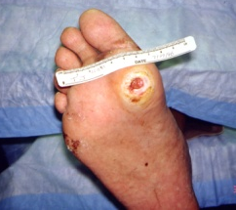
Diabetic Neuropathic Foot Ulcers
Evidence: Consistent Off-loading Has Best Outcomes
Total Contact Cast
Bioengineered Skin
Bioengineered Dermis
Removable Walker
Platelet Releasate
Gauze
RhPDGF BB
Placebo
Gauze
Gauze
Armstrong D.. et al. Diab Care, 2005;28:551–554. : 12 weeks
Falanga V. Wounds, 2000;12(5) :42A. 12 weeks
Smiell J. et al. Wound Rep Regen 1999; 7:335: 20 weeks
Pollack R. Wounds 1997;9(1):175. 12weeks
(5) Bentkover JD, Champion AH. Wounds, 1993; 5(4):207-215: 20 weeks
Notes:
For diabetic foot ulcers, the overwhelming evidence supports consistent off-loading.
The best clinical benchmark for healing results we could find for Wagner grade 1-2 diabetic neuropathic ulcer healing were reported by Armstrong, Lavery and colleagues with 83% healing in 12 weeks or less using standard care with a total contact cast (TCC) and moist wound healing dressing on the ulcer. Only 52% healed if patients could remove their off-loading device—no different from all the advanced interventions with RCT data. Frykberg et al, just emphasized this point in a supplement to WOUNDS available at this meeting.
Platelet releasate reported nearly 60% healed in 20 weeks.
Apligraf 55% healed in 12 weeks,
Dermagraft 51% healed in 12 weeks and
Regranex best reported outcome was 48% healed in 20 weeks.
Hyalofill® healed 62% of recalcitrand diabetic foot ulcers in 13 weeks. (Small trial only 22 patients. A much larger trial is in progress.

Slide 33
More Wounds Healed Faster Than Historic Controls Using EB Practice in Home Telemedicine¹
¹ Kobza L, Scheurich A. Ostomy/Wound Manag. 2000; 46(10):48-53
Notes:
In case you’re wondering if these results work in the real world, they do: for all wounds!
In a cohort of 76 consecutive patients implementing EB protocols of moist wound healing, off-loading for PU and DU or compression for VU, WOCNs Laura Kobza and Ann Scheurich reported significantly faster healing times for all types of chronic wounds in their home care telemedicine clients practices while significantly reducing costs and the number of home care visits required to heal each wound, compared to pre-protocol 120 comparable patients.

Slide 34
Implementing EB validated wound care guideline adapted for Nova Scotia home care reduced time and costs to healing or discharge to family care.¹
1. McIsaac C. O/WM 2005 Apr;51(4):54-6, 58, 59 passim.
¹Numbers in parentheses are total clients healed during specified year,
not total receiving care.
Notes:
Corrine McIsaac and her colleagues on the Nova Scotia provincial wound care committee implemented an adaptation of these same evidence-based principles to improve home wound care healing time by more than 90% while saving more than $3000 per patient healed.

Slide 35
Science sets you free to improve wound care outcomes!
Fact: Evidence bases patient-oriented wound care on knowledge
Better, more reliable outcomes for
  Patient
  Wound
Progress to be proud of
  Faster healing
  pain, complications, cost
Achieve Winning Outcomes
Evidence
Notes:
So the take home message is that you can achieve winning outcomes based on evidence:
Better, more reliable outcomes for both patient and wound.
Don’t believe the myths about E-B practice, free yourself to use relevant facts to get the best results for your patients.
As you watch the results unfold by measuring progress toward the goals of wound care, you will stand on the shoulders of others whose pioneering research reported faster healing and less pain and complications like scarring or infection, while saving resources to increase your team’s effectiveness in meeting patients’ wound care needs.
1. Realize the potential of science to improve clinical and patient-oriented wound care outcomes
2. Separate myth from fact about evidence-based wound care
3. Appreciate the value of measuring progress toward each goal of wound care
While there are obstacles to EB practice, from a practical point of view the benefits outweigh the limitations:
You derive better, more reliable, safer outcomes for your patients at lower cost.
Practitioners or nurses on different shifts will not undo each others' work
You'll only handle each wound once--heal it fast and prevent recurrence
Your credibility and respect depends on your ability to get results. Your patients will recommend you as a credible, respectable source of wound or ostomy care. The evidence you use and generate will help bring wound care out of the dark ages and earn its place among the other EB medical fields.
Reimbursement authorities increasingly base their decisions on treatment modalities that have evidence proving they work, so if you use EBM, you will be more likely to be adequately reimbursed for it..and don’t be fooled by cheap care that doesn’t work: the most expensive intervention is one that doesn’t work, no matter how little it costs!

